Slide 1
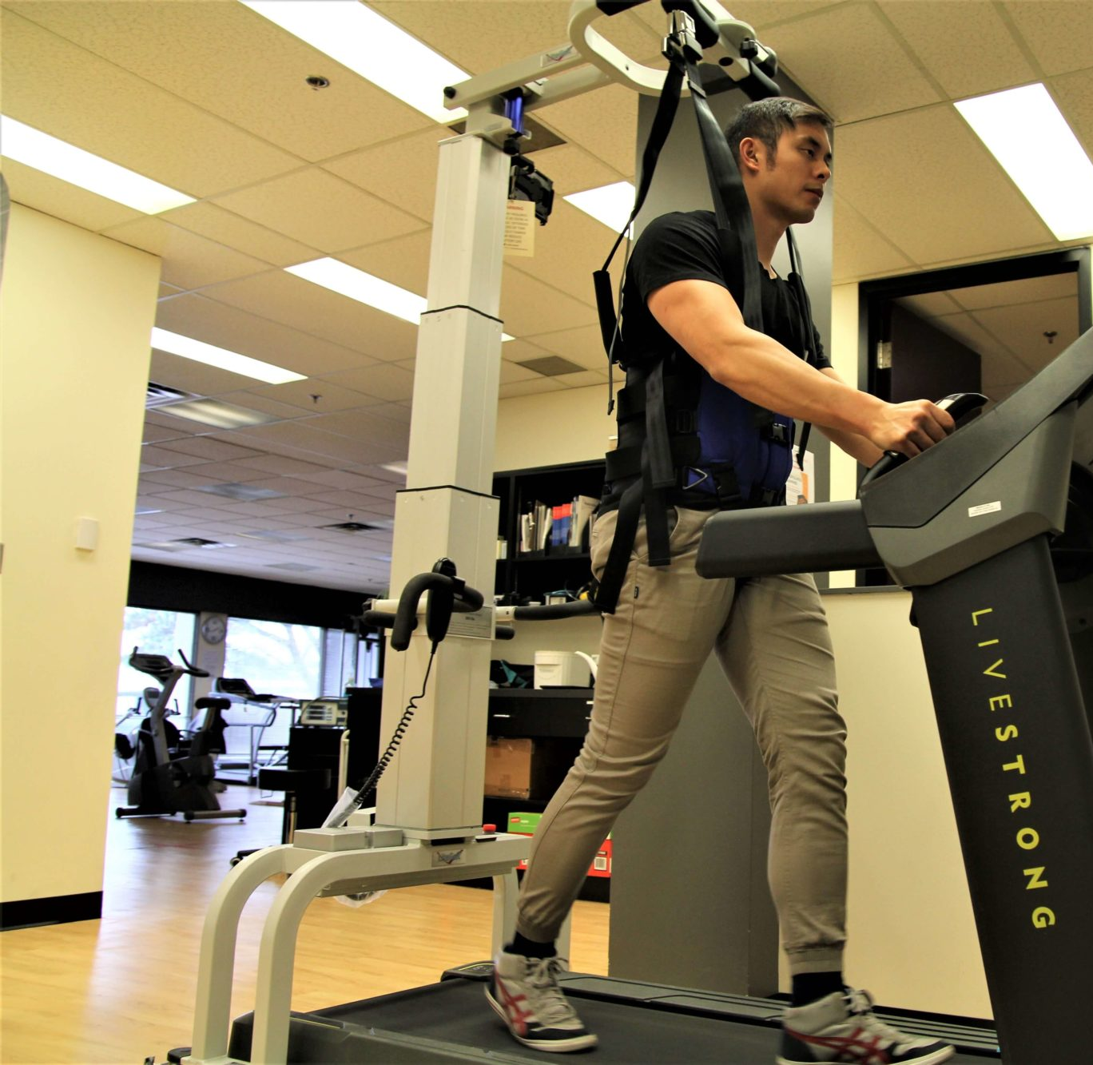
Retraining Mobility
Dr Mark McGlinchey
Consultant Physiotherapist
Guy’s and St Thomas’ NHS Foundation Trust

Slide 2
By the end of this lecture, students should be able to
discuss the evidence for the efficacy of physiotherapy in lower limb and gait rehabilitation including partial weight support, treadmill training, strength training, and endurance training
devise a treatment plan for rehabilitation of lower limb function including gait

Slide 3
Lower Limb and Gait Dysfunction
Neurological impairment, such as weakness, sensory loss, and pain, can result in gait dysfunction (Lennon et al. 2024)
Regaining and improving walking is cited as one of the most common goals by people with stroke undergoing rehabilitation and living in the community (Eng and Tang 2007)
Interventions designed to improve lower limb and gait dysfunction can be aimed at all levels of disability- impairment, activity limitation, participation restriction

Slide 4
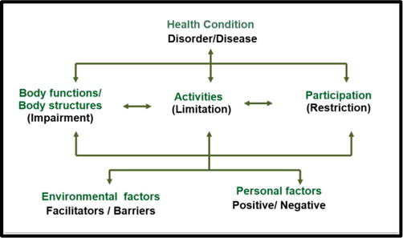
International Classification of Functioning, Disability and Health (ICF)

Slide 5
Rehabilitation for Lower Limb and Gait Dysfunction
Physiotherapy interventions are guided by a variety of factors, including assessment findings, patient preference and goals, clinician expertise, therapist beliefs and attitudes, research evidence and workplace practices (McGlinchey et al. 2024)
Evidence supports repetitive and intensive practice of walking and exercise using aids and equipment as necessary to enable safe practice and mobility during usual activities post-stroke (ISWP 2023)
Reassessment of an intervention’s effectiveness is facilitated through outcome measurement and goal attainment

Slide 6
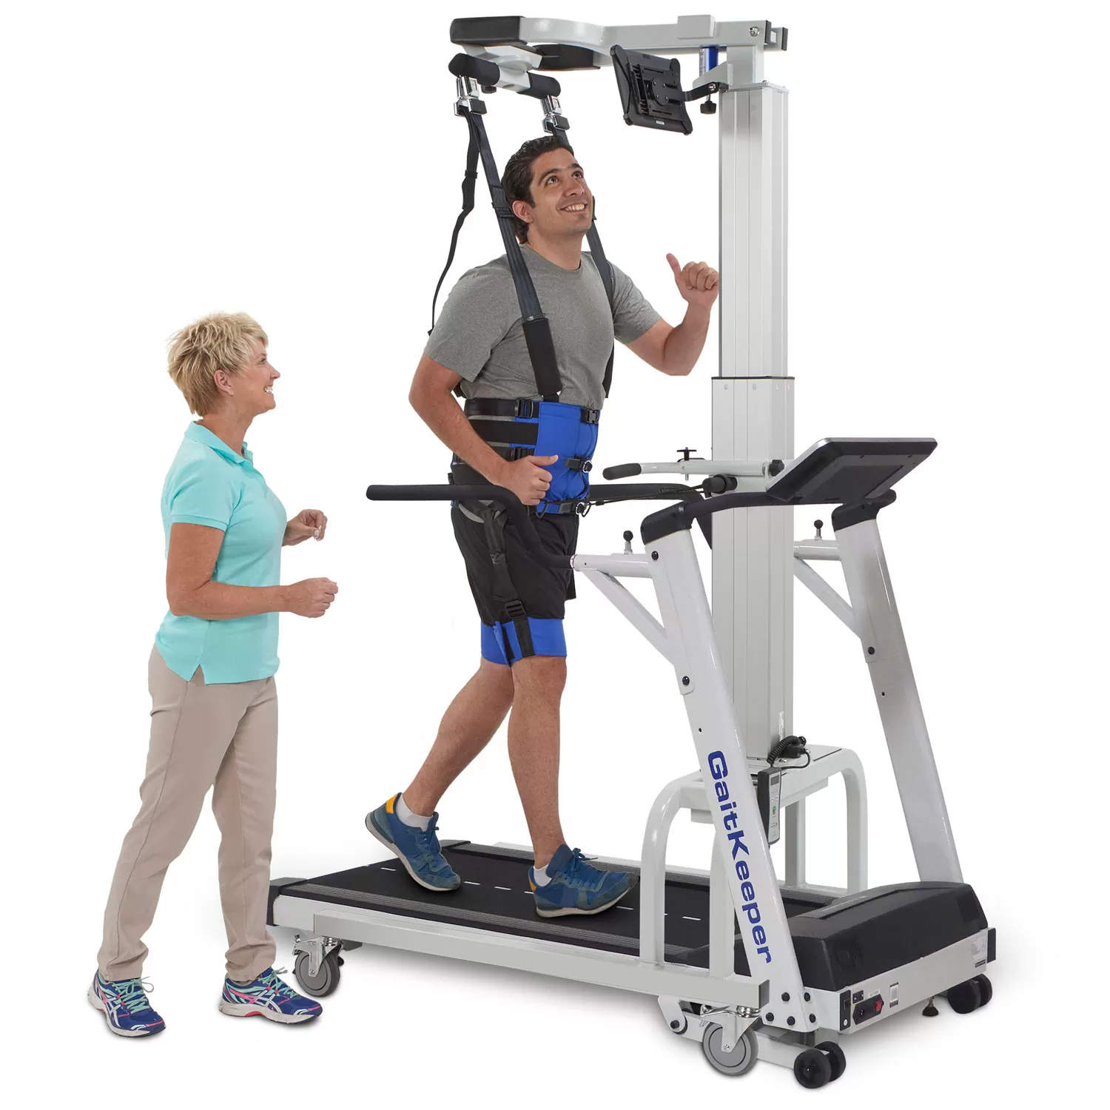
Treadmill Training and Partial Body Weight Support
whole task practice of gait
supportive harness to off-load body weight from the legs
as gait improves, support is decreased as patient required to control a greater percentage of body weight
research has focused on stroke, Parkinson’s disease and spinal cord injury

Slide 7
Treadmill training and body weight support- stroke
Merholz et al. (2017)
treadmill training and/or PBWS vs conventional gait training
56 RCTs: 3,105 participants (average age 60 years, inpatients and outpatients)
no significant differences in walking independence
short term significant benefits on walking speed and endurance in ambulant stroke patients
no significant benefits at scheduled follow-up/long term

Slide 8
Electromechanicaland robot-assisted gait training
- stroke
Merholz et al. (2020)
electromechanical- and robot-assisted gait training vs normal care
62 RCTs: 2,440 participants (age 47 – 76 years)
increased likelihood of independence in gait and increased walking speed but not walking distance
non-ambulant stroke survivors particularly in the first 3 months post-stroke more likely to gain benefit than ambulant stroke survivors
long term effects uncertain

Slide 9
Treadmill training and body weight support- Parkinson’s disease
Merholz et al. (2015)
treadmill training vs conventional gait training/no treatment
18 RCTs: 633 participants (age 58-74)
significant differences: gait speed and stride length
no significant differences: walking distance and cadence
long term effects uncertain

Slide 10
Treadmill training- spinal cord injury
Merholz et al. (2017)
bodyweight supported treadmill training or robotic locomotor training vs overground gait training and other physiotherapy
13 RCTs: 586 participants (age 16-68)
all levels of spinal involvement (C1-L4) and impairment (AIS Grade A-D) included
no significant differences in walking speed or walking distance

Slide 11
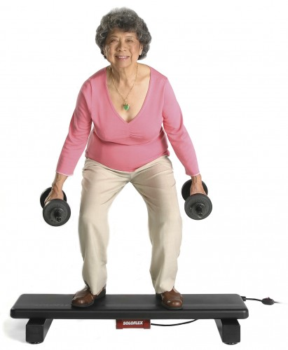
Strength Training
weakness is one of the most common impairments post-stroke
historical concerns about worsening spasticity due to physical exertion have been disputed (Dodd and Morris 2004, Ada et al. 2006)
resistance training (body weight or equipment) is the most effective modality to improve muscle strength post-stroke (Saunders et al. 2020)

Slide 12
Evidence for post-stroke physiotherapy – strengthening exercise
Veerbeek et al. (2014)
467 RCTs (25,373 participants) of 53 interventions
strong evidence that higher dose of practice is better for muscle strength of paretic leg

Slide 13
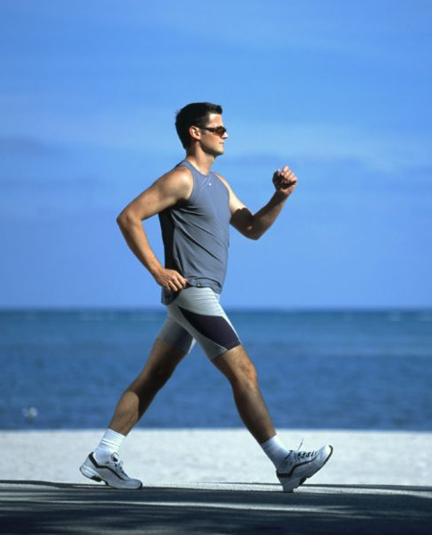
Endurance Training
Cardiovascular disease is the leading prospective cause of death in chronic stroke
Aerobic exercise can
        reduce resting BP
        improve lipid profiles
        improve glucose tolerance and insulin profiles
Reducing systolic resting BP by 10 mmHg can lead to a ¹/₃ reduced risk of stroke

Slide 14
Physical fitness training post-stroke
Saunders et al. (2020)
75 RCTs: 3017 participants
  cardiorespiratory training (n=32, 1631 participants)
  resistance training (n=20, 779 participants)
  mixed training interventions (n=23, 1207 participants)
exercise is safe: very few deaths overall, no serious adverse events
significant reductions in disability by cardiorespiratory and mixed training interventions
multiple benefits for physical fitness (VO₂ peak and strength), mobility (walking speed) and physical function (balance)

Slide 15
Practical considerations
Luo et al. (2020)
facilities and equipment to support high-intensity (>70% peak heart rate) cardiorespiratory fitness training (e.g. bodyweight support treadmills and/or static/recumbent cycles)
training dose should be at least 30-40 minutes, 3-5 times a week for 10-20 weeks
programmes of mixed training should also be available at least 3 days per week for 20 weeks
exercise aimed at increasing heart rate should be used for those with more severe weakness, such as using arm cycles or seated exercise groups

Slide 16
Treatment plan
For the following clips, develop a treatment
plan considering:
Likely impairments
Dosage including starting position
Ways to progress/regress treatment
Outcome measurement

Slide 17
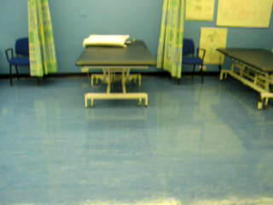

Slide 18
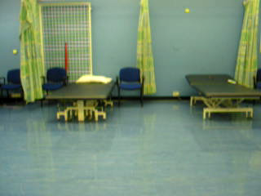

Slide 19
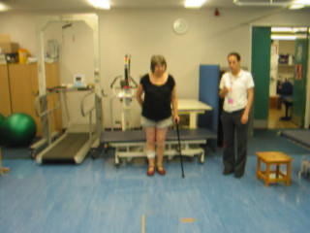

Slide 20
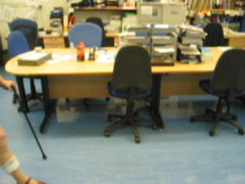

Slide 21
Reference List
Ada L, Dorsch S & Canning C. Strengthening interventions increase strength and improve activity after stroke: a systematic review. Australian Journal of Physiotherapy 2006, 52(4), 241–248
Dodd KJ & Morris ME. Outcomes of progressive resistance strength training following stroke: a systematic review. Clinical Rehabilitation 2004, 18(1), 27–39
Eng J and Tang P. Gait training strategies to optimize walking ability in people with stroke: a synthesis of the evidence. Expert Review of Neurotherapeutics 2007, 7(10), 1417-1436
Lennon S, Ramdharry G and Verheyden G. Physical Management for Neurological Conditions. 5th edition 2024. Elsevier
Luo L, Meng H, Wang Z et al. Effect of high-intensity exercise on cardiorespiratory fitness in stroke survivors: A systematic review and meta-analysis Annals of Physical and Rehabilitation Medicine 2020 63(1), 59-68
McGlinchey MP, Faulkner-Gurstein R, Sackley CM et al. Factors guiding therapist decision making in the rehabilitation of physical function after severely disabling stroke – an ethnographic study, Disability and Rehabilitation 2024, 46(4), 672-684

Slide 22
Reference List
Merholz J, Kugler J, Storch A et al. Treadmill training for patients with Parkinson's disease. Cochrane Database of Systematic Reviews 2015, Issue 9. Art. No.: CD007830. DOI: 10.1002/14651858.CD007830.pub4.
Merholz J, Thomas S, Elsner B. Treadmill training and body weight support for walking after stroke. Cochrane Database of Systematic Reviews 2017, Issue 8. Art. No.: CD002840
Merholz J, Harvey L, Thomas S et al. Is body-weight-supported treadmill training or robotic-assisted gait training superior to overground gait training and other forms of physiotherapy in people with spinal cord injury? A systematic review. Spinal Cord 2017, 55, 722–729
Merholz J, Thomas S, Kugler J, Pohl M, Elsner B. Electromechanical-assisted training for walking after stroke. Cochrane Database Syst Rev. 2020 Oct 22;10(10):CD006185
National Clinical Guideline for Stroke for the UK and Ireland. London: Intercollegiate Stroke Working Party; 2023. Available at: www.strokeguideline.org
Saunders DH, Sanderson M, Hayes S et al. Physical fitness training for stroke patients. Cochrane Database of Systematic Reviews 2020, Issue 3. Art. No.: CD003316
Veerbeek JM, van Wegen E, van Peppen R et al. What Is the Evidence for Physical Therapy Poststroke? A Systematic Review and Meta-Analysis. PLoS ONE 2014, 9(2): e87987

